Slide 1

Call Back Design Pattern
BY
EHSANULLAH 068
ABDULLAH JAVED 052

Slide 2


Presentation Outline
1.Intent
2. Also Known As
3.Applicability
4.Structural Diagram
5.Participants

Slide 3
Course Outline
6. Problem Statements
7. Code Examples

Slide 4

Call Back Design Pattern
Intent: The Callback Design Pattern is a behavioral design pattern that allows a method to notify its client about the progress, completion, or result of an operation. In this pattern, a client provides a callback (a function or method) to another object, and the object invokes the callback at the appropriate time.
Intent

Slide 5

Also Known As
Also Known As:
Completion Handler
Event Handler
Callback Function

Slide 6

Applicability
When to use
You want to allow clients to customize certain behavior without changing the main logic.
You need a way to notify clients about the completion of an asynchronous operation.
You want to implement event handling where an object needs to notify others about changes or events.

Slide 7

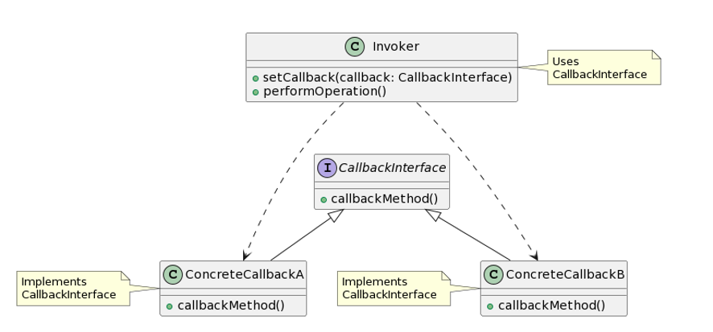
Structural Diagram
The structural diagram for the Callback Design Pattern typically involves at least two participants:
Invoker/Caller: The object that initiates the operation and holds a reference to the callback.
Callback Interface/Function: The interface or function that the client provides, defining the method to be called back.

Slide 8
Participants
Invoker/Caller:
Description: The object or component that initiates an operation and holds a reference to the callback.
Responsibility: Initiates the operation and triggers the callback at the appropriate time.
Example: In an asynchronous file reader, the reader is the invoker that calls a callback upon reading completion.
Callback Interface/Function:
Description: An interface or function provided by the client, defining the method to be called back.
Responsibility: Contains the callback method that the invoker will invoke.
Example: In a callback for file reading, a FileReadCallback interface might define a method like onFileReadComplete().
It participants

Slide 9
Problem Statements
Asynchronous Operations:
Issue: Performing asynchronous operations, such as file I/O or network requests, and notifying the client when the operation completes.
Solution: Use a callback to handle the completion event.
Customization in Frameworks:
Issue: Creating extensible frameworks where clients can customize certain behavior.
Solution: Allow clients to provide callbacks to customize behavior within the framework.
Event Handling:
Issue: Implementing event-driven systems where objects need to react to changes or events.
Solution: Use callbacks to notify interested parties about events.

Slide 10
Code Examples
javascript
// Asynchronous operation with callback
function readFileAsync(filePath, callback) {
// Simulating asynchronous file read
setTimeout(() => {
const content = "File content goes here.";
callback(null, content); // Notify completion with content
}, 1000);
}
// Client code providing a callback
readFileAsync("example.txt", (error, content) => {
if (error) {
console.error("Error:", error);
} else {
console.log("File content:", content);
}
});

Slide 11

Thank You!
EHSANULLAH
ABDULLAH JAVED

